Slide 1

COMP 499/691: Conversational Artificial Intelligence
Automatic Speech Recognition (ASR)
Part 2
Computer Science & Software Engineering
Concordia University, Winter 2024

Slide 2
Summary of the last episode….
What we have seen last time:
Introduction to speech recognition
Today, we will continue our discussion on speech recognition :
Beamsearch
Language Models
CTC
Transducers
Performance Measurement
Datasets

Slide 3
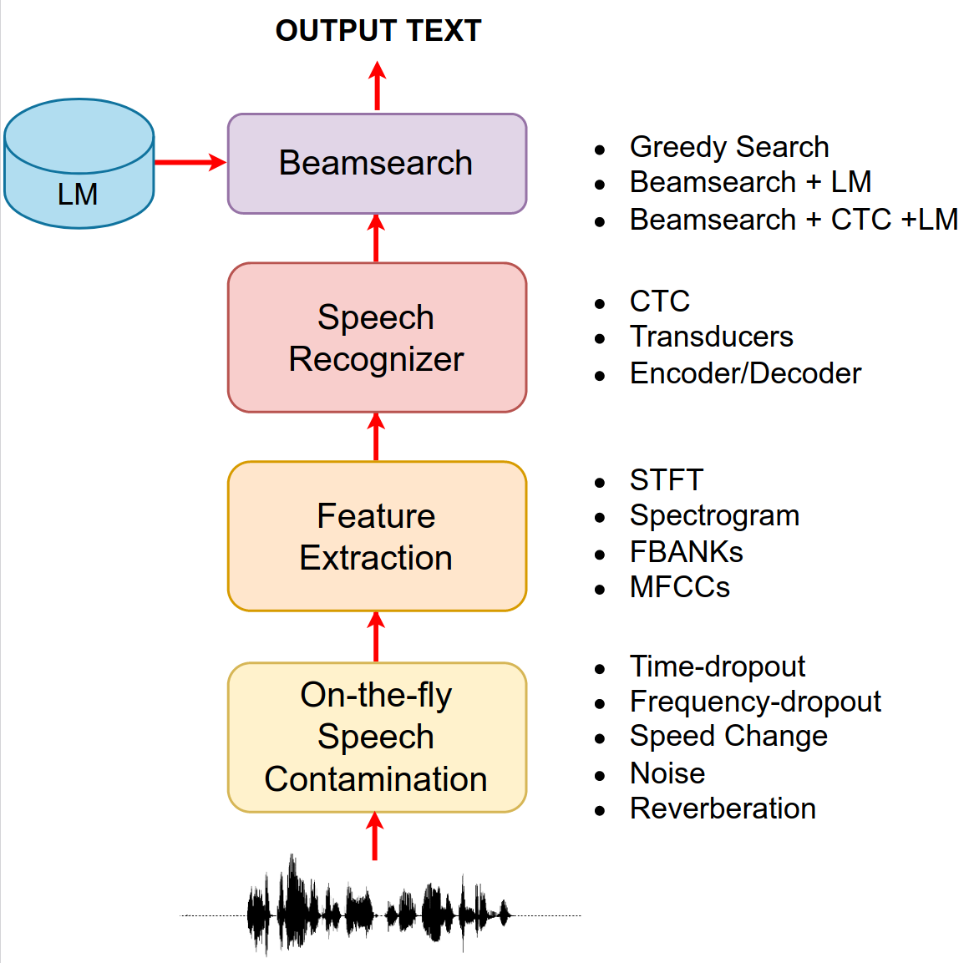
Speech Recognition
A speech recognizer is composed of different modules:
Data contamination is a regularization technique used to improve the performance and minimize the risk of overfitting.
Feature Extraction extracts some features on top of the waveform.
The Speech Recognizer is a neural network that predicts a sequence of probabilities over the adopted tokens (e.g, characters, words, BPE).
Beamsearch is a search algorithm used on top of these probabilities to improve the ASR performance.

Slide 4
Beamsearch

Slide 5
Beamsearch
Beamsearch
Beamsearch is a search algorithm.
We explore step-by-step different alternatives and keep alive the most promising ones.
The "beam" refers to the number of alternatives that the algorithm considers at each step.
The alternatives can be optionally rescored with an external language model (rescoring).

Slide 6

Beamsearch
The simplest way to get a sequence of words from the sequence of probability is by greedy search.
In greedy search, we just take the word with the highest probability at each decoding step:
w₁
w₂
w₃
…
w₁
w_{N}
w₂
w₃
…
w_{N}
w₁
w₂
w₃
…
w_{N}
w₁
w₂
w₃
…
w_{N}
What is its limitation?
Softmax
Softmax
Softmax
Softmax
Linear
Greedy search makes decisions based solely on current information.
Linear
Linear
Linear
Attention
Attention
Attention
Attention
RNN
RNN
RNN
…………………
RNN
Locally Optimal
≠
Globally Optimal
Emb
Emb
Emb
Emb
<bos>
The
cat
table
Choices made at each step may be locally optimal but not lead to the best overall solution.

Slide 7

Beamsearch
What about considering K candidates at each time step?
I
I
Love
Love
I
We can keep alive the most promising partial hypothesis.
cat
I
cat
Love
Love
my
cat
<bos>
my
cat
I
At each decoding step, we consider the best K hypothesis.
I
my
my
Love
Love
cat
I
cat
This solution is still not optimal (as we prune non-promising hypotheses) but better that a simple greedy search.
my
Love
my
cat
my
Decoding Step1
Decoding Step2
Decoding Step3
Decoding Step4

Slide 8
Beamsearch
Now, we'll look at how beamsearch operates in an RNN-based system. To keep things simple, we'll consider words as tokens:
w₁
w₂
w₃
…
w_{N}
Hyp | Score
<bos> + w1 (“The”) | 0.3
<bos> + w2 (“How”) | 0.1
<bos> + w3 (“This”) | 0.3
<bos> + … | 0.1
<bos> + wN (“That”) | 0.2
In the first decoding step, we feed <bos> in input
Softmax
The decoder predicts probabilities over the next possible word.
Linear
Attention
Decoder
RNN
We select the K words with the highest probability:
Emb
Hyp | Score
<bos> + w1 (“The”) | 0.3
<bos> + w3 (“This”) | 0.3
<bos> + wN (“That”) | 0.2
<bos>
Step 1

Slide 9
Beamsearch
Hyp | Score
<bos> + The + w1 | 0.3 * 0.0
<bos> + The + w2 | 0.3 * 0.1
<bos> + The + w.. | 0.3 * 0.4
<bos> + The + wN | 0.3 * 0.0
<bos> + This + w1 | 0.3 * 0.1
<bos> + This + w2 | 0.3 * 0.0
<bos> + This + w.. | 0.3 * 0.6
<bos> + That + w1 | 0.2 * 0.0
…. | 0.2 * 0.3
<bos> + That + wN | 0.3 * 0.1
We feed the top K words into the second decoding step.
w₁
w₂
w₃
…
w_{N}
w₁
w₂
w₃
…
w_{N}
We compute the output probabilities over all the words for each top K word.
Softmax
Softmax
Linear
Linear
Attention
Attention
The current score is the product between the previous score and the output probability.
RNN
RNN
Among all the combinations, we select the top k sequences of words:
Emb
Emb
<bos>
<The> 0.3
<This> 0.3
<That> 0.2
Hyp | Score
<bos> + w1 (“the”) + w7 (“cat”) | 0.3*0.4
<bos> + w2 (“this”) + w9 (“mad”) | 0.3*0.2
<bos> + w1 (“the”) + w8 (“bat”) | 0.3*0.2
Step 1
Step 2

Slide 10
Beamsearch
We move on this way until the <eos> token is emitted.
w₁
w₂
w₃
…
w_{N}
w₁
w₂
w₃
…
w_{N}
w₁
w₂
w₃
…
w_{N}
Softmax
Softmax
Softmax
Hyp | Score
<bos> + w1 + w7 + w10 + w11 + w16 +<eos> | 0.3*0.4*...* 0.1
<bos> + w2 + w9 + w10 + w16 +<eos> | 0.3*0.2*...*0.4
<bos> + w1 + w8 +w10 + w11 + <eos> | 0.3*0.2*..*0.1
Linear
Linear
Linear
Attention
Attention
Attention
RNN
RNN
RNN
……………
Emb
Emb
Emb
<bos>
<The> 0.3
<This> 0.3
<That> 0.2
<cat> 0.3 * 0.4
<mad> 0.3 * 0.2
<bat> 0.3 * 0.2

Slide 11
Beamsearch
word
score
word
score
word
score
word
score
The
0.3
The cat
0.12
The cat is
0.06
The cat is on the table <eos>
0.005
Top K
This
0.3
This mad
0.06
This mad is
0.02
……
This mad is on this table <eos>
0.001
This
0.2
The bat
0.06
The bat in
0.01
The cat is on this cable <eos>
0.001
w₁
w₂
w₃
…
w₁
w_{N}
w₂
w₃
…
w_{N}
w₁
w₂
w₃
…
w_{N}
w₁
w₂
w₃
…
w_{N}
Softmax
Softmax
Softmax
Softmax
At the end, we select the world with the highest score.
Linear
Linear
Linear
Linear
Attention
Attention
Attention
Attention
RNN
RNN
RNN
…………………
RNN
Emb
Emb
Emb
Emb
<bos>
The
This
That
cat
mad
bat
table
the
cable

Slide 12
Beamsearch
Several heuristics and enhancements can be employed to improve beamsearch.
word
score
word
score
word
score
word
score
The
0.3
The cat
0.12
The cat is
0.06
The cat is on the table <eos>
0.005
Top K
This
0.3
This mad
0.06
This mad is
0.02
………..
This mad is on this table <eos>
0.001
This
0.2
The bat
0.06
The bat in
0.01
The cat is on this cable <eos>
0.001
Step 1
Step 2
Step 3
Step N
What does it happen if we multiply probabilities over many decoding steps?
The score will get smaller and smaller until it reaches numerical underflow.
How can we fix that?

Slide 13
Beamsearch
To avoid numerical issues we can use log probabilities.
This way, we can sum scores rather than multiply them.
word
score
Log score
The cat is on the table <eos>
0.005
-5.29
This mad is on this table <eos>
0.001
-6.90
The cat is on this cable <eos>
0.001
-6.90
Step N
Do you see other issues?

Slide 14
Beamsearch
The partial hypotheses that we explore might have a different number of words.
There might be alternatives where the <eos> token is emitted earlier and others where it is emitted later.
word
score
Log score
The cat is on the table <eos>
0.005
-5.29
The score, which is the sum of log probabilities, has the undesired consequence of favoring short transcriptions (because multiplying small probabilities results in a higher value).
This mad is on this table <eos>
0.001
-6.90
The cat is on this cable <eos>
0.001
-6.90
Step N
How can we fix that?

Slide 15
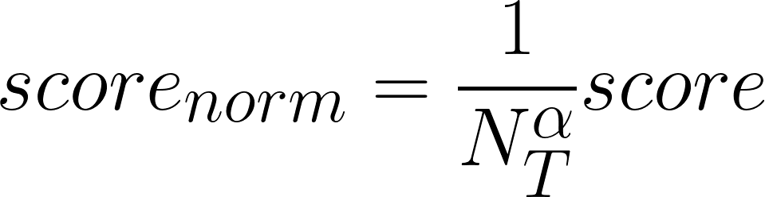
Beamsearch
To mitigate this issue, we normalize the final score by dividing it by the number of tokens:
N_{T} is the number of tokens emitted before <eos>.
α is a length penalization hyperparameter.
α = 0
Strong length penalization
α = 1.0
No length penalization
Many other heuristics are implemented to enhance beamsearch. You'll learn about some of them in this week's tutorial!

Slide 16
Beamsearch
At every decoding step, beamsearch provides the top K hypothesis with a corresponding score:
word
score
The cat is on the table <eos>
0.005
This mad is on this table <eos>
0.001
The cat is on this cable <eos>
0.001
Step N
A useful aspect of beam search is that it enables us to rescore these partial hypotheses based on certain prior information.
As an example, we may desire to boost the score of a hypothesis that is linguistically sounding, while reducing the score of a hypothesis that lacks meaningful linguistic content.
This type of rescoring can be done with a language model.

Slide 17
Combining ASR and Language Models

Slide 18
Combining ASR and Language Models
In our upcoming lecture, we will discuss language models deeply.
In this lecture, we will focus on how we can use language model information within a speech recognizer to improve the performance.
For now, remember that:
The Language Model (LM) assigns a probability to each sequence of words w.
More frequently occurring sequences of words (e.g., 'I love cats') are assigned higher scores compared to unlikely sequences (e.g., 'I you to').

Slide 19
Combining ASR and Language Models
One approach to train a language model on large text corpora using a neural network that predicts the next word:
w₁
w₂
w₃
…
w_{N}
w₁
w₂
w₃
…
w_{N}
w₁
w₂
w₃
…
w_{N}
w₁
w₂
w₃
…
w_{N}
Softmax
Softmax
Softmax
Softmax
Linear
Linear
Linear
Linear
LM
RNN
RNN
RNN
…………………
RNN
Emb
Emb
Emb
Emb
<bos>
The
cat
table
There are various ways to utilize a language model within a speech recognizer.
The most commonly used method involves rescoring the partial hypotheses using a language model during beamsearch.

Slide 20

Combining ASR and Language Models
During beamsearch, we have K partial hypotheses with their corresponding score
Partial Hypotheses
Log score
Log LM score
Ideally, we want to increase the score of linguistically plausible hypotheses and reduce it for those not plausible.
The cat is on the
-5.68
-1.34
This mad is on this
-6.98
-3.98
The cat is on this
-6.00
-1.50
Step i
We can use the language model to compute how likely each hypothesis is from a pure linguistic point of view.
The final score is a linear combination between the acoustic score and the language one:
This is a hyperparameter that balances the relative importance of acoustic and linguistic information.

Slide 21
Language Models
Let us assume that we have a pre-trained speech recognizer that is trained on speech data and a language model that is trained on text data.
We also assume that both models are autoregressive and share the same output tokens.
We can integrate the acoustic and language scores by running the speech recognizer and the language models concurrently.
Run both the speech recognizer and the language model on the current best hypotheses.
2. Each model will provide a score.
The total score is a linear combination of the acoustic and language scores.
3. We select the top K hypotheses based on the best total scores.
Emb
Emb
Emb
Emb
<bos>
The
This
That
cat
mad
bat
table
the
cable

Slide 22
Language Models
Hyp
LogScore
LogScore LM
LogScore tot (λ_{LM}=1)
Softmax
Softmax
Softmax
Softmax
The
-1.20
-1.1
-2.30
Linear
Linear
Linear
Linear
Attention
Attention
Attention
Attention
This
-1.32
-1.4
-2.73
ASR
(decoder)
RNN
RNN
RNN
…………………
RNN
That
-1.34
-1.3
-2.64
Emb
Emb
Emb
Emb
Step 1
<bos>
The
This
That
cat
mad
bat
table
the
cable
Hyp
LogScore
LogScore LM
LogScore tot (λ_{LM}=1)
The cat
-1.40
-2.1
-2.30 -2.5
Softmax
Softmax
Softmax
Softmax
This mad
-2.51
-2.8
2.73 -5.31
Linear
Linear
Linear
Linear
That bat
-3.30
-3.3
2.64 -6.60
LM
RNN
RNN
RNN
…………………
RNN
Step 2
Emb
Emb
Emb
Emb
score
word
score
word
score
…………………
<bos>
The
This
That
cat
mad
bat
table
the
cable
0.12
The cat is
0.06
The cat is on the table <eos>
0.005
0.06
This mad is
0.02
……
This mad is on this table <eos>
0.001
0.06
The bat in
0.01
The cat is on this cable <eos>
0.001
w₁
w₂
w₃
…
…
w_{N}
w_{N}
w₁
w₂
w₃
…
w_{N}

Slide 23
Connectionist Temporal Classification
(CTC)

Slide 24
Connectionist Temporal Classification (CTC)
So far, we have seen Encoder-Decoder ASR models.
Despite their excellent performance and flexibility, they are not suitable for streamable ASR.
In certain applications, it is desirable for an ASR system to produce output in real-time as speech is being spoken, instead of waiting until the end of a speech segment to generate output.
Standard encoder-decoder architectures cannot achieve this as decoding can only begin after the encoder has processed all the time steps.
Fortunately, there are ASR models that are suitable for stremability.
Speech recognizers based on connectionist temporal classification (CTC) are an example.

Slide 25
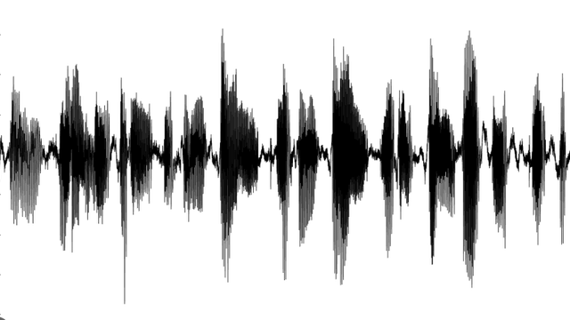
Connectionist Temporal Classification (CTC)
CTC-based speech recognizers are an alternative to encoder-decoder architecture.
We do not have a decoder, but only an encoder.
For each time step, the encoder outputs a prediction (for simplicity, we here consider characters as output tokens):
c
a
a
t
t
The number of encoded steps can be different from the number of output tokens.
RNN
Encoder
Let’s assume that the number of encoded steps is smaller than the number of outputs.
In this case, some consecutive time steps will have the same label.
x1
x2
x3
...
xN

Slide 26
Connectionist Temporal Classification (CTC)
c
a
a
t
t
At inference time, we can simply predict the token emitted at each time step and remove repetitions:
c a a t t
c a t
RNN
Encoder
Do you see issues with that?
x1
x2
x3
...
xN
We have no way to produce outputs with multiple consecutive characters in a row.
For instance, the output for [h, h, e, l, l, l, o] will collapse to “helo” instead of “hello”
h h e l l l o
helo

Slide 27
Connectionist Temporal Classification (CTC)
c
a
a
t
t
At inference time, we can simply predict the token emitted at each time step and remove repetitions:
c a a t t
c a t
RNN
Encoder
Do you see other issues?
x1
x2
x3
...
xN
In speech signals, we might have silences before, after, or even within words.
We need to add a special token that allows the model to emit silences.

Slide 28
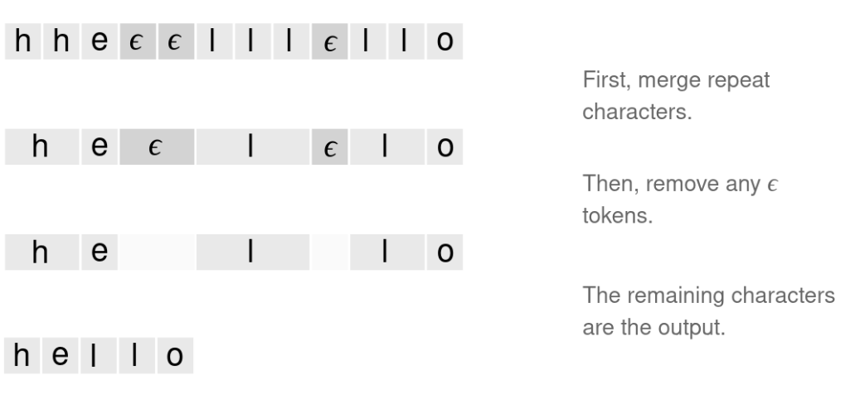

Connectionist Temporal Classification (CTC)
To solve both issues, we add a special token called “blank” (ϵ)
This allows the network to output nothing in some steps.
The ϵ token does not correspond to anything and is simply removed from the output:
c
ϵ
a
t
ϵ
RNN
Encoder
x1
x2
x3
...
xN
In order to represent consecutive identical characters (such as the "ll" in "hello"), an "ϵ" symbol must be inserted between them. With this rule, we can differentiate between alignments that collapse to “hello” and those which collapse to “helo”.

Slide 29
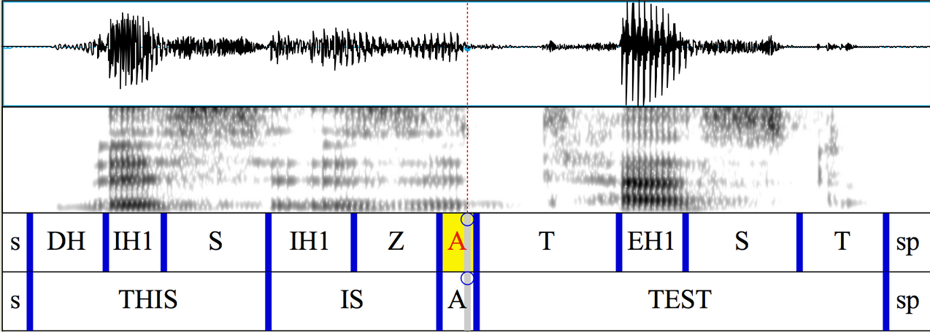
Connectionist Temporal Classification (CTC)
There is another problem that can prevent us from training such a model
Do you see issues with that?
The problem is that in most speech datasets, labels are not available for every time step.
The datasets provide only the sequence of words spoken, without the corresponding time boundaries for each word, character, or token.
No word/token alignments, such as the one shown, are available.
This type of annotation is highly expensive and time-consuming.
We only know that the transcription for this sentences is “This is a test”, but we do not know where is located the “T”, the “H”, the “I”, etc.
In other words, the alignment between the input speech signal and the corresponding output tokens is not available.

Slide 30
Connectionist Temporal Classification (CTC)
We only know that the transcription for this sentence is “This is a test”, but we do not know where is located the “T”, the “H”, the “I”, etc.
In other words, the alignment between the input speech signal and the corresponding output tokens is not available.

Slide 31

Connectionist Temporal Classification (CTC)
In encoder-decoder ASR models, we overcome this issue by training the model to learn the alignment between the input speech signal and the corresponding output tokens.
Cross-attention, which is used in both RNN and Transformer-based systems, enables the model to learn a soft alignment.
In a CTC-based speech recognizer, we even don’t have a decoder.
How can we train a speech recognizer without the alignment information?
In CTC, we consider all the possible alignments between the input speech signal and the corresponding output tokens.

Slide 32
Connectionist Temporal Classification (CTC)
There are tons of possible alignments:
h ϵ e ϵ l ϵ l o
Not all the alignments are equally probable.
h h e ϵ l ϵ l o
According to the model, some alignments are more likely than others.
h h e e l ϵ l o
ϵ h e l ϵ l o ϵ
We can compute the probability of each alignment.
…….
The CTC loss is a weighted sum of all the possible input-output alignments.
The weight depends on how likely is each specific alignment.

Slide 33
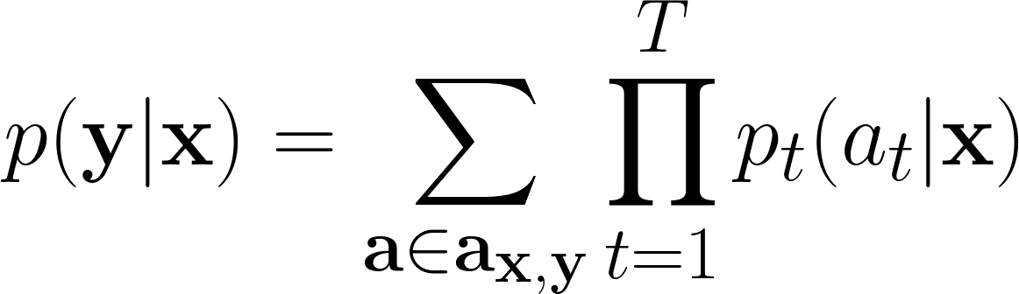
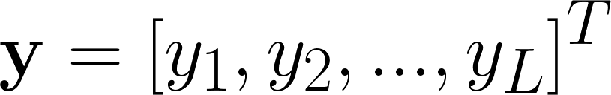
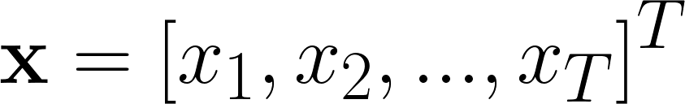
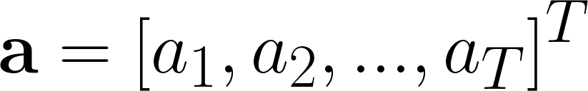
Connectionist Temporal Classification (CTC)
More formally, the CTC loss can be expressed as:
Probability for a single alignment (step-by-step)
CTC loss (conditional probability)
Marginalization over the set of valid alignments
Sequence of tokens (label, e.g, “h e l l o”)
Input sequence
Alignment (ϵ h e l ϵ l o ϵ )

Slide 34
Connectionist Temporal Classification (CTC)
The CTC loss can be calculated in a naive manner using the following steps:
Consider all possible alignments between the input data and the output labels.
Calculate the probability of each alignment based on the model's predictions.
Sum up all the alignment probabilities.
To compute the probability of a specific alignment, we can multiply the probabilities observed at each time step together
c
a
a
t
0.01
ϵ
ϵ
c
0.03
Encoder
a
t
ϵ
CTC loss
RNN
+
c
a
a
ϵ
t
0.06
c
ϵ
a
t
ϵ
0.02
x1
x2
x3
...
xN
…………
….

Slide 35

Connectionist Temporal Classification (CTC)
This naive approach is computationally expensive, especially for long sentences that contain a lot of tokens.
We need something clever here!
Don't worry, folks! dynamic programming is here to save us (again)!
Dynamic programming makes solving the problem feasible by breaking it down into smaller parts, storing the scores from each partial hypothesis, and reusing them as needed.

Slide 36
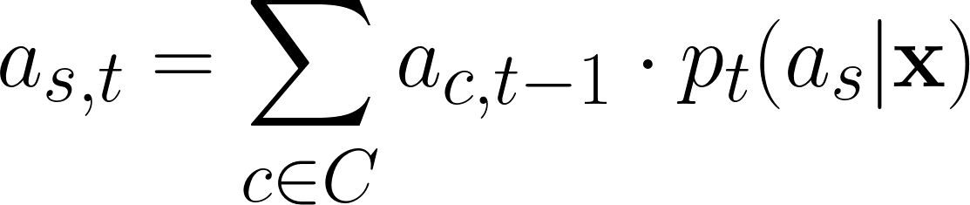
Connectionist Temporal Classification (CTC)
key insight: we can sum up the scores from the alignments that reach the same output.
We sum up the scores of these two paths and store their sum into a variable α
c
c
c
c
c
The alignments are monotonic (if our word is “cat” we can move from “c” to “a”, but not from “c” to “t” directly).
a
a
a
a
a
In each node, we update the score as follows:
Set of output tokens
t
t
t
t
t
ϵ
ϵ
ϵ
ϵ
ϵ
Time steps
We sum up the scores of the connected nodes C
We multiply by the probability of observing the token s at time t

Slide 37
Connectionist Temporal Classification (CTC)
Is the CTC loss differentiable?
Labels
CTC Loss
L1
L2
L3
...
LL
Yes, it is differentiable and we can backpropagate through it
posteriors
ϵ
c
a
ϵ
t
We can use the CTC loss on top of the encoder and train our speech recognizer.
Encoder
The implementation of the CTC is critical as it is not vectorizable and requires ”for loops”.
Fortunately, we have available efficient Cuda and c++ implementations (also in pytorch).
x1
x2
x3
...
xN

Slide 38
Connectionist Temporal Classification (CTC)
What do we do at inference time?
ϵ
c
a
ϵ
t
One approach is to apply greedy search:
At each time step, we take the token with the highest probability.
Encoder
We then clean up the transcription by removing repetitions and the blank token:
x1
x2
x3
...
xN
ϵ c a ϵ t t ϵ
c a t
As an alternative, we can use a modified version of the beamsearch algorithm discussed earlier.
Note that the model is streamable as it can start generating output in real-time as soon as it begins receiving the input signal.

Slide 39
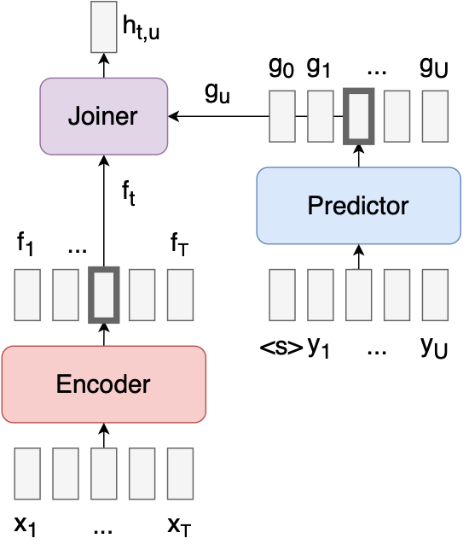
Transducers
CTC works really well and many systems used it in combination with pre-trained self-supervised models (such as wav2vec, wavLM, etc).
An alternative is Transducers (sometimes referred to as RNN-transducers).
RNN transducers are composed of three neural networks:
Encoder: takes as input the features and transforms them into a higher-level representation.
Predictor: It is an autoregressive network that takes as input the previous outputs and produces features that can be used for predicting the next output (similarly to a standard language model).
Joiner: it is a simple feedforward network that combines the encoder vector f_{t} and predictor vector g_{u}

Slide 40
Transducers
We train the model with a loss that integrates over all the possible alignments (similar to the CTC one).
Transducers can be seen as an evolution of CTC.
They can lead to better performance, as they introduce a language model into the ASR architecture directly.
The price to pay is an increased computational complexity.
In particular, at training time the model is very memory-demanding as it requires allocating big tensors.

Slide 41
Performance

Slide 42
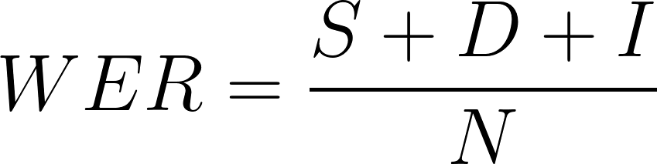
Performance
We measure the performance of a speech recognizer with the word-error-rate (WER):
Substitution:
Reference text: “I love cats”
Recognized text: “I love dogs”
S is the number of substitutions
D is the number of deletions.
I is the number of insertions.
N is the number of words in the reference.
Deletion:
Reference text: “I love cats”
Recognized text: “love cats”
Insertion:
The WER is derived from the Levenshtein distance also called edit distance.
Reference text: “I love cats”
Recognized text: “I love the cats”

Slide 43

Performance
To compute the word error rate, we first need to align the reference and recognized text:
260-123440-0009, %WER 33.33 [ 3 / 9, 0 ins, 1 del, 2 sub ]
I ; SHALL ; NEVER ; GET ; TO ; TWENTY ; AT ; THAT ; RATE
= ; = ; = ; = ; = ; S ; D ; = ; S
I ; SHALL ; NEVER ; GET ; TO ; TWENTIETH ; <eps> ; THAT ; RIGHT
After, the alignment we can compute the number of substitution, deletion, and insertion errors.
How can we compute the alignment efficiently?
No, we cannot train a model with the WER directly.
We need to use Negative Log Likelihood as a surrogate.
Again, with dynamic programming!
Is the WER computation differentiable?

Slide 44
Performance
The performance of a speech recognizer depends on several factors, including:
Quality of the audio signal.
2. Data availability: when large supervised datasets are available the performance is better.
3. Model size: Larger models tend to have better performance.
4. Type of Speech: Read speech is much easier than conversational speech.
5. Type of Language: Some languages are easier than others.
For instance, Italian is easier than English.

Slide 45
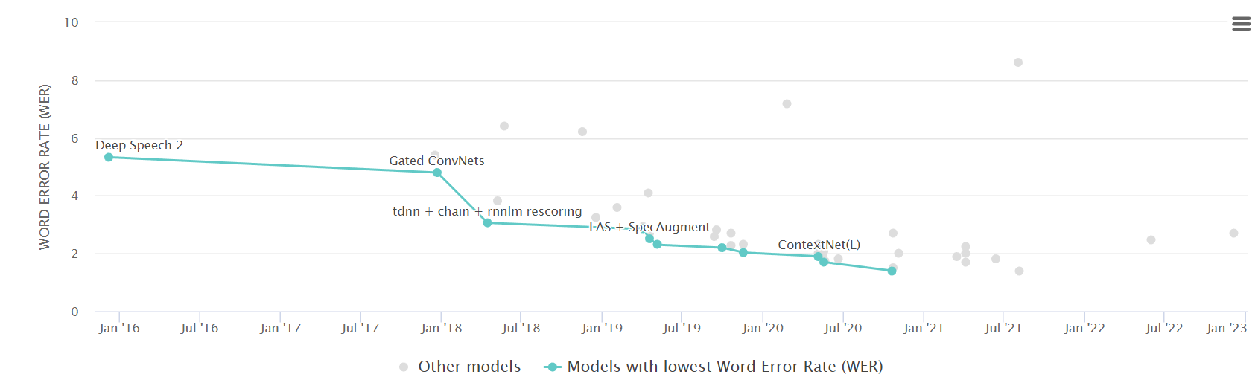
Performance
Performance on test-clean Librispeech (WER below 2%):
In Librispeech we have “Ideal conditions” for a speech recognizer:
Clean signals, read speech, large dataset (1000 hours)

Slide 46

Performance
Performance on CHiME 6 (WER above 30%):
In CHiME 6, we have challenging conditions” for a speech recognizer:
Noisy signals, Conversational speech, small dataset.

Slide 47
References
[1] Awni Hannun, Ann Lee, Qiantong Xu, Ronan Collobert, “Sequence-to-Sequence Speech Recognition with Time-Depth Separable Convolutions’, Paper
[2] Jan Chorowski, Navdeep Jaitly, “Towards better decoding and language model integration in sequence to sequence models”, Paper
[3] Shubham Toshniwal, Anjuli Kannan, Chung-Cheng Chiu, Yonghui Wu, Tara N Sainath, Karen Livescu, "A comparison of techniques for language model integration in encoder-decoder speech recognition." Paper
[4] https://d2l.ai/chapter_recurrent-modern/beam-search.html
[5] https://distill.pub/2017/ctc/
[6] https://lorenlugosch.github.io/posts/2020/11/transducer/?ref=assemblyai.com

Slide 48


Lab Session
During the weekly lab session, we will do:
Beamsearch
Integrating ASR and LMs
Deadline: March, 31 11.59 pm

